Slide 1
Dell.com Customer Recommendation System
Rich Caputo

Slide 2
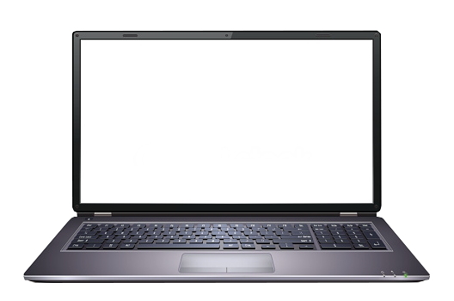
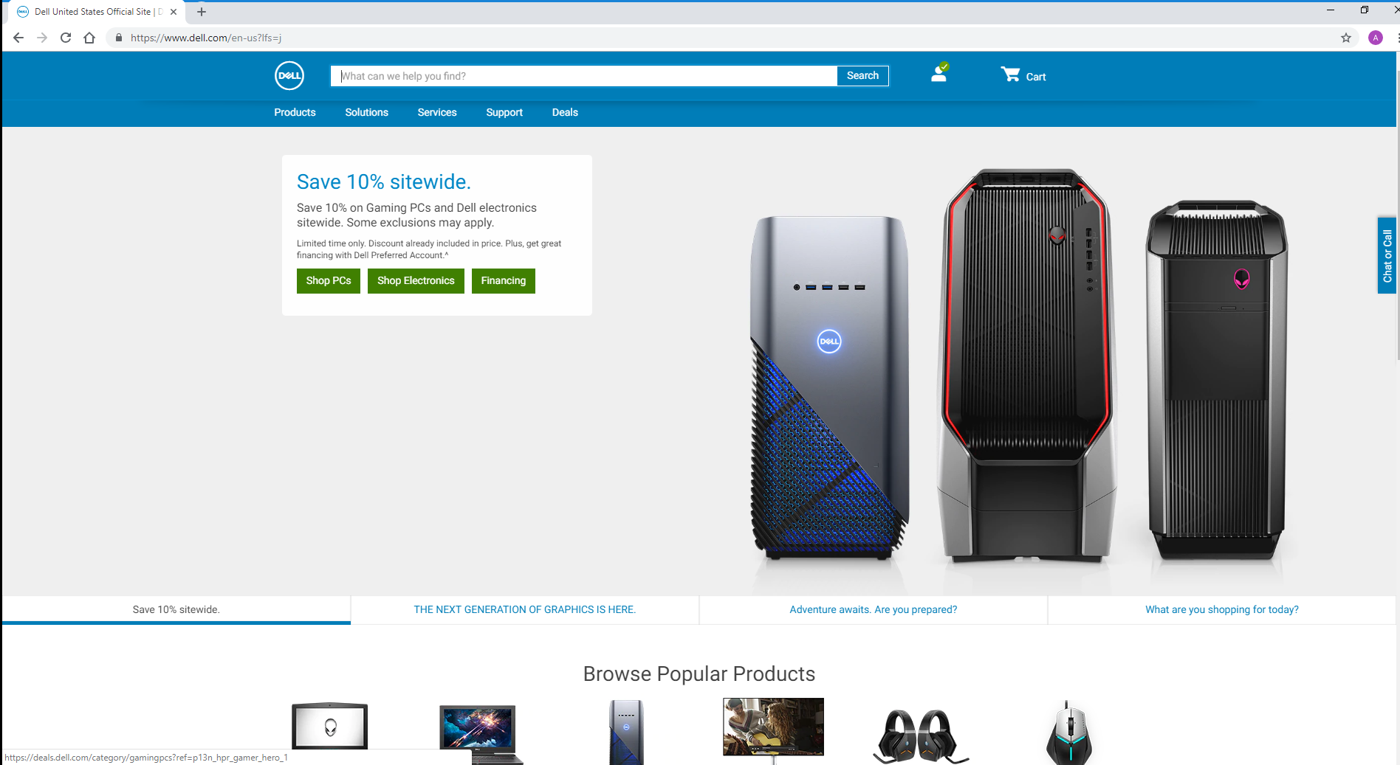
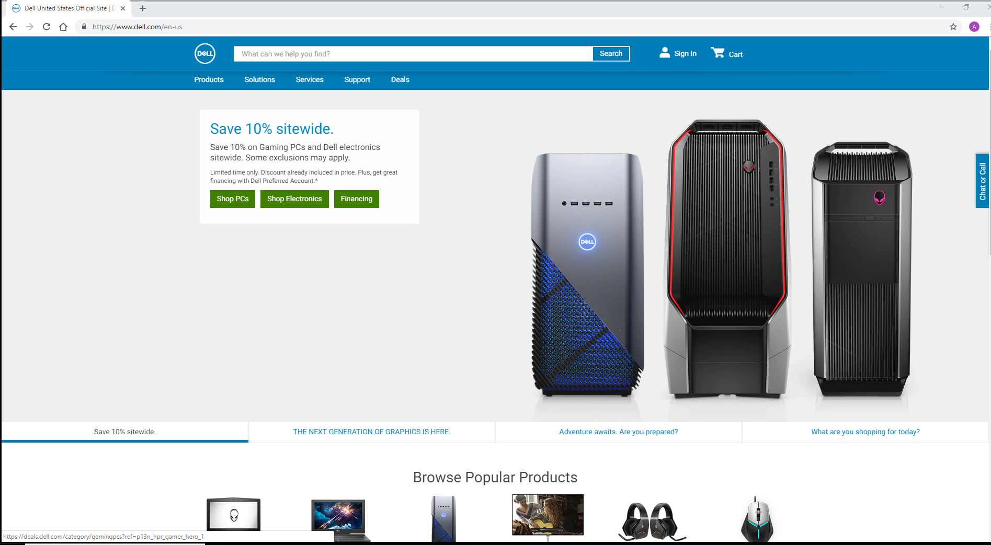

Problem Statement:
When a customer logs into Dell.com, there is no personalization, nor are there recommendations for the returning customer!
Logged in
Exactly the same
According to McKinsey:
"Already, 35 percent of what consumers purchase on Amazon and 75 percent of what they watch on Netflix come from product recommendations based on such [recommendation] algorithms." [1]
Not logged in

Slide 3
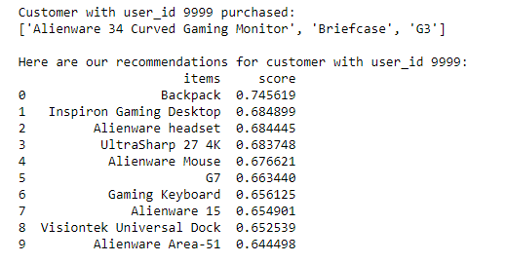
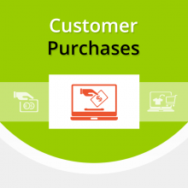
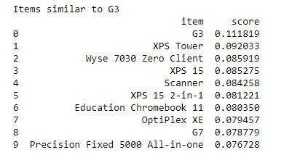


Solution

Slide 4
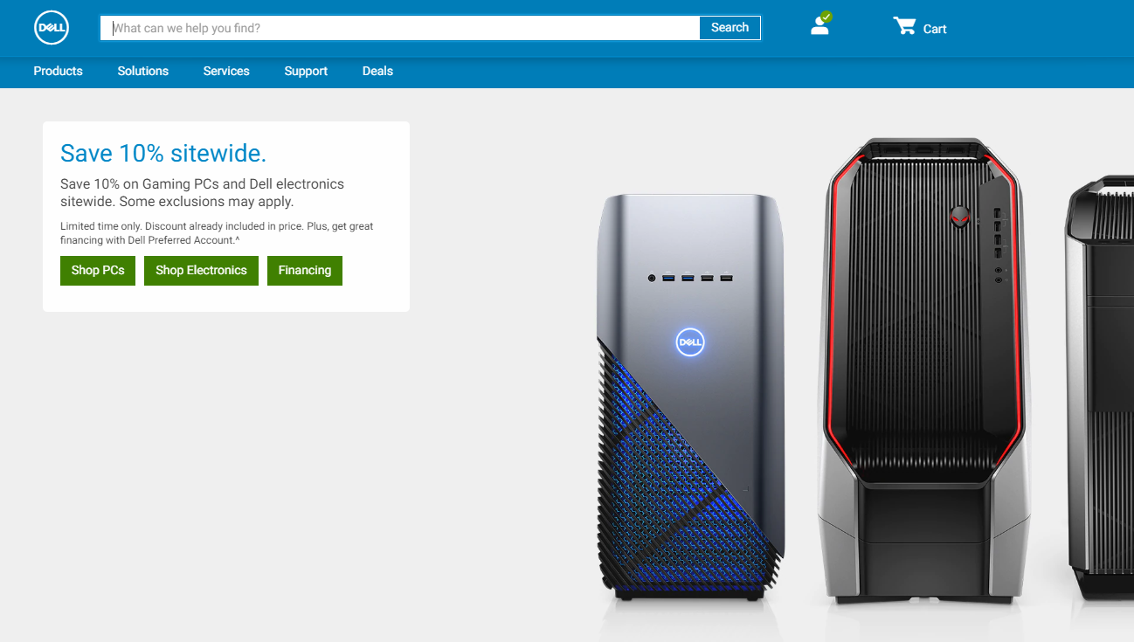
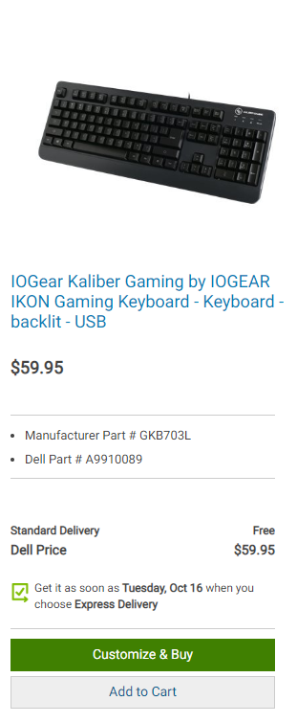
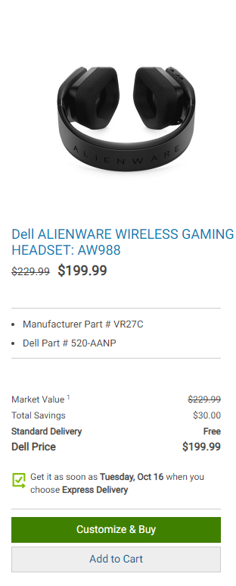
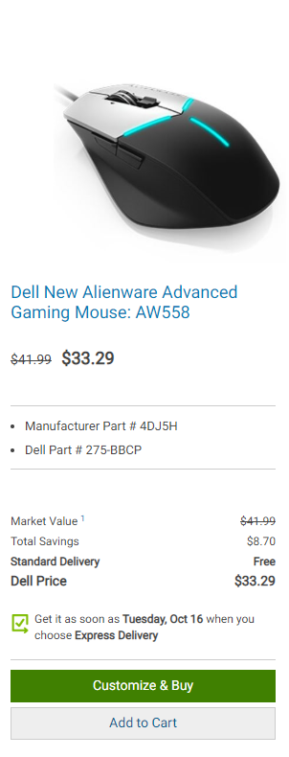
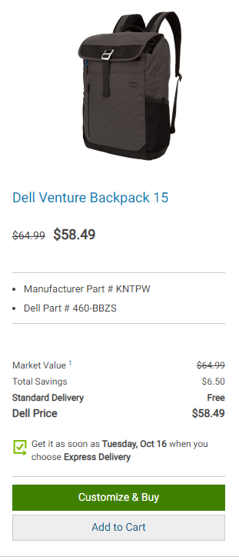
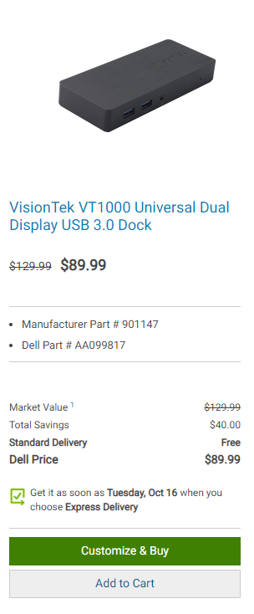
Welcome back, Rich Caputo! Here are some recommendations for you

Slide 5
Thank You! Questions?

Slide 6

References
[1] https://www.mckinsey.com/industries/retail/our-insights/how-retailers-can-keep-up-with-consumers.
Project Demo: file:///C:/Users/caputr/Ideathon_Project/Dell_recommendation_system%20(1).html

